Slide 1
Acknowledgement of Country
In the spirit of reconciliation, the University of Southern Queensland recognises that it is situated on country for which the Jarowair and Giabal people have been custodians for many centuries and on which they have performed age-old ceremonies of celebration, initiation and renewal. We acknowledge their living culture and unique role in the life of this region and offer our deep appreciation for their contribution to, and support of, our academic enterprise.
Copyright This slide presentation is licensed under a Creative Commons Attribution NonCommercial Licence 4.0 by the University of Southern Queensland, Toowoomba, Australia.
Note that corporate logos (such as the USQ Phoenix, and any other company represented) and branding are specifically excluded from the Creative Commons Attribution NonCommercial Licence 4.0 of this work, and may not be reproduced under any circumstances without the express written permission of the copyright holders.

Slide 2
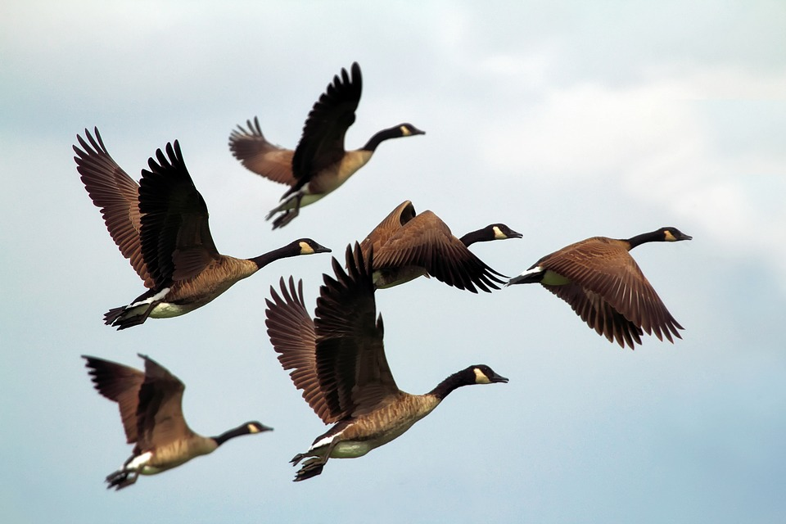
Openness as ‘everyone’s business’ Collaboration in open text production (and beyond)
Tahnee Pearse,
Associate Director (Content),
USQ Library, and
Adrian Stagg, Manager
(Open Educational Practice), OALT
Education Portfolio
University of Southern Queensland
Australia

Slide 3
Who are our students?

Slide 4
Who are our students?
Nearly 80% of all students are online
60% are ‘first-in-family’
40% are located in a regional or rural/remote environment
24% are identified as being from a low socio-economic status (determined by Australian Bureau of Statistics measures)
As a student-focused strategy, openness makes sense to improve access, and reduce barriers to a university education.

Slide 5
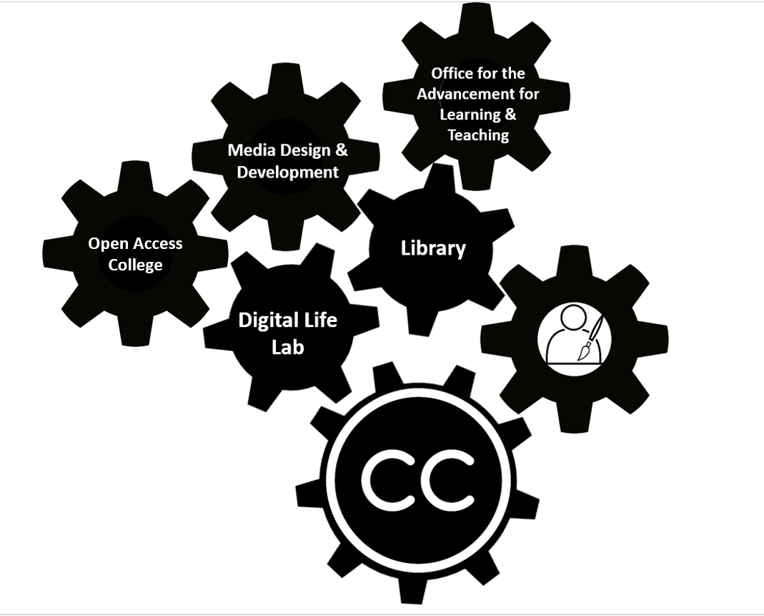
Open is Everyone’s Business

Slide 6
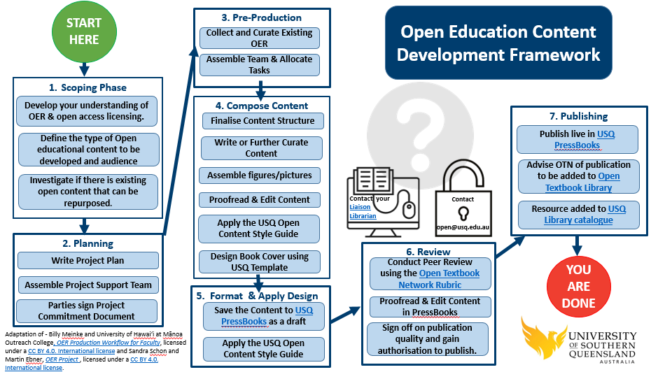
NOT!!

Slide 7
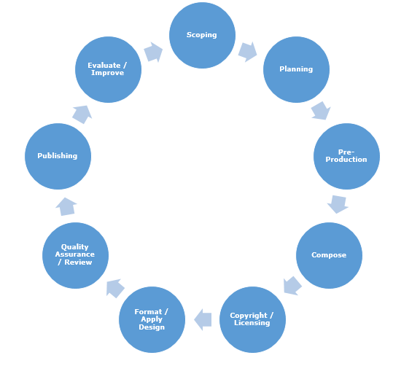
OECD

Slide 8
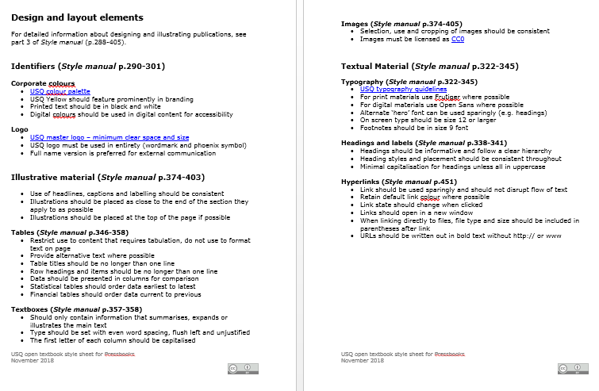
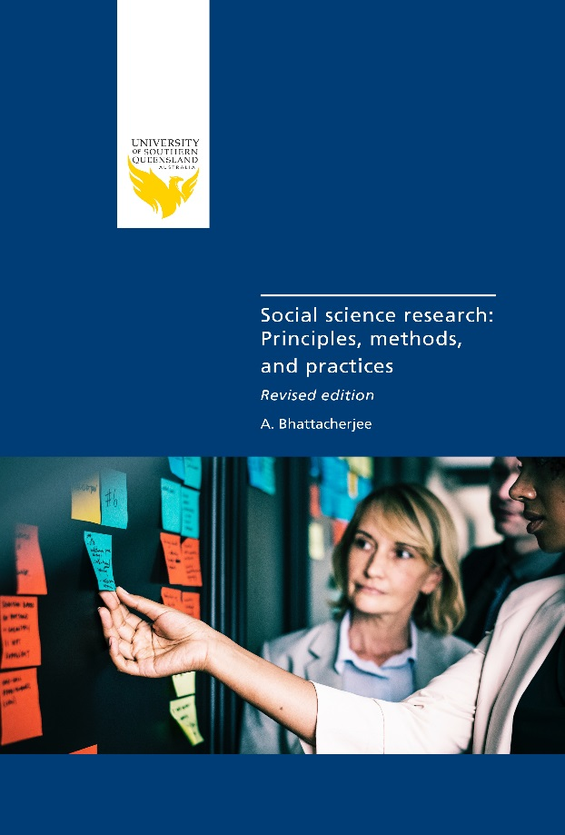

Slide 9
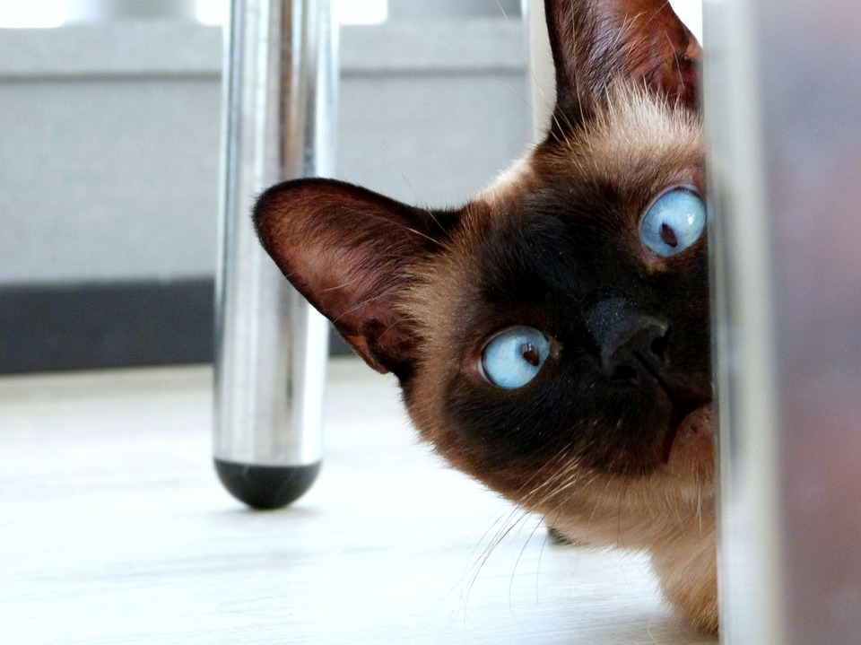
What’s ‘just around the corner’ for USQ and openness?

Slide 10
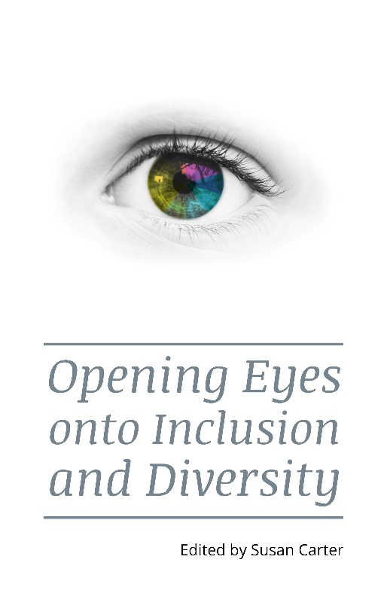
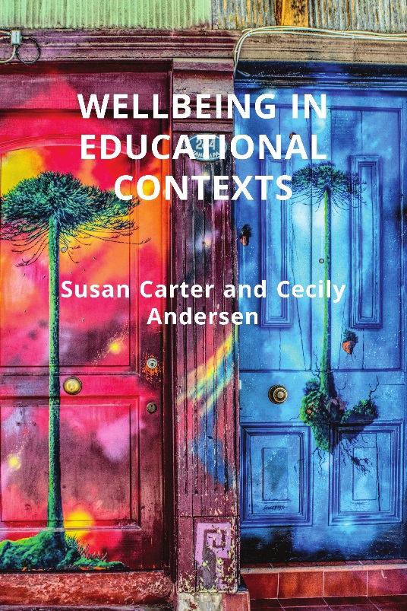
Looking into the future: next steps
2019 Focus areas:
Open Textbooks, and Open Assessment (funded and BAU)
Open Textbook Publishing Kit
More textbooks…

Slide 11
Adrian Stagg | Manager (Open Educational Practice) | @OpenKuroko
Tahnee Pearse | Associate Director (Content) | @TahneePearse
Copyright This slide presentation is licensed under a Creative Commons Attribution NonCommercial Licence 4.0 by the University of Southern Queensland, Toowoomba, Australia.
Note that corporate logos (such as the USQ Phoenix, and any other company represented) and branding are specifically excluded from the Creative Commons Attribution NonCommercial Licence 4.0 of this work, and may not be reproduced under any circumstances without the express written permission of the copyright holders.

